Slide 1

Project Management with Agile: Week-4 Project Cost Management Dr. Bhuvan UNHELKAR Professor of Information Technology www.Unhelkar.com; Office: C225; bunhelkar@sar.usf.edu; 941-359-4654

Slide 2
Lecture Agenda
Overview of Project Cost Management
And linking it to Time Management (Previous Lecture)
Plan Cost Management
Estimate Costs (map to Time)
Determine Budgets
Control Costs
Undertake Short Exercises
Apply the discussion to the case study

Slide 3

Module: Project Cost Management - Overview
Based on Project Cost Management Knowledge Area
(Chapter 7 of PMBOK ® )
MethodScience.com

Slide 4
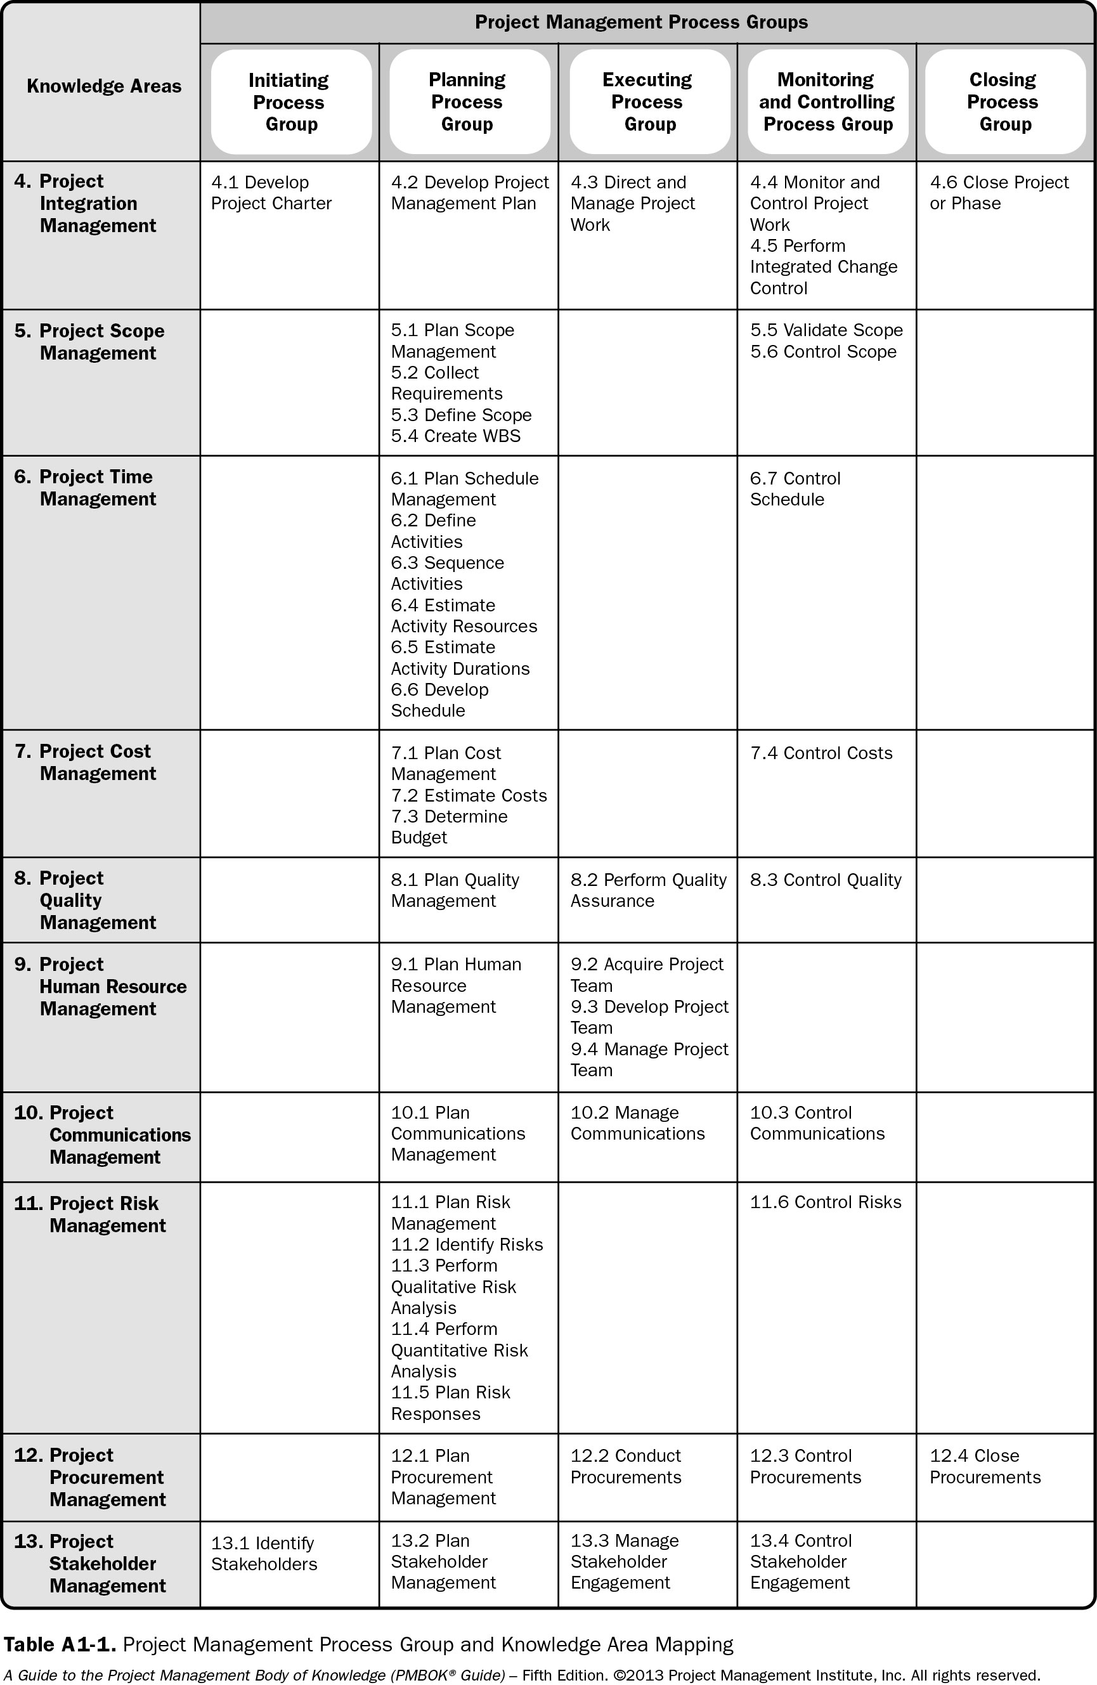
Process Groups – Knowledge Areas

Slide 5
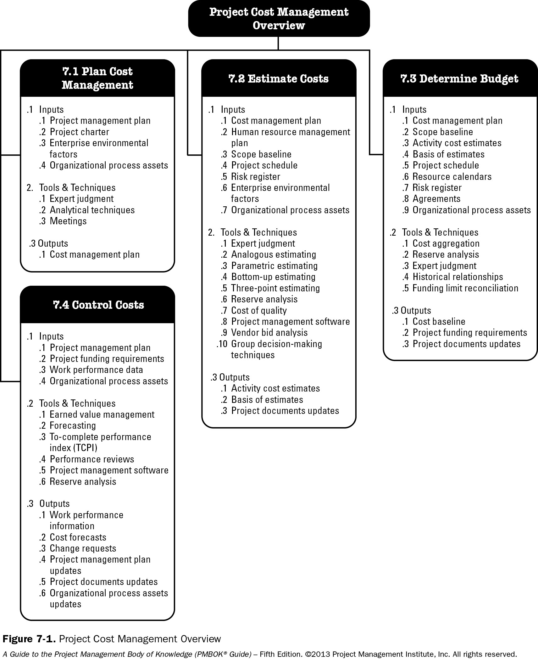

Project Cost Management

Slide 6
Module: 7.1 Plan Cost Management
Based on Project Cost Management Knowledge Area
(Chapter 7 of PMBOK ® )
MethodScience.com

Slide 7
7.1 Plan Cost Management
It is the process that establishes the policies, procedures, and documentation for planning, managing, expanding, and controlling project costs.
Part of overall Project Planning

Slide 8

Inputs to “Plan Cost Management”
Project Management Plan
Project Charter
Enterprise Environmental Factors
Organizational Process Assets

Slide 9

Tools and techniques to “Plan Cost Management”
Expert Judgment
Analytical Techniques
Meetings

Slide 10
Outputs of “Plan Cost Management”
Cost Management Plan - It is a component of the project management plan. It describes how the project costs will be planned, structured, and controlled. It may
Define the points in the WBS at which measurement of control accounts will be performed;
Establish the earned value measurement techniques (e.g., weighted milestones, fixed-formula, percent complete, etc.)
Specify tracking methodologies and the earned value management computation equations.
Reporting formats. The formats and frequency for the various cost reports are defined.

Slide 11
Short Exercise
List two differences in the way Tools & Techniques for planning Costs differs from planning Schedule (time):
A: ___________________________________
B:____________________________________

Slide 12


Discussion, Q & A
Do you think the Organizational Culture has an effect on the approach to estimating Costs of a project in an organization?
Why?
Notes:
You may want to note down answers and comments from Fellow participants here...

Slide 13
Module: 7.2 Estimate Costs
Based on Project Cost Management Knowledge Area
(Chapter 7 of PMBOK ® )
MethodScience.com

Slide 14
7.2 Estimate Costs
It is the process of developing an approximation of the monetary resources needed to complete project activities.
Cost estimates include the identification and consideration of costing alternatives.
Cost trade-offs and risks should be considered, such as make versus buy, buy versus lease, and the sharing of resources in order to achieve optimal costs.
Cost estimates are generally expressed in units of some currency (i.e., dollars, euros, yen, etc.)
Cost estimate should be reviewed and refined during the course of the project.

Slide 15
Estimate Costs – 1
The accuracy of a project estimate will increase as the project progresses through the project life cycle.
Costs are estimated for all resources which includes labor, materials, equipment, services, and facilities, as well as special categories such as an inflation allowance, cost of financing, or contingency costs.
Cost estimate is a quantitative assessment of the likely costs for resources.

Slide 16
Inputs to “Estimate Costs”
Cost Management Plan
Human Resource Management Plan
Scope Baseline
Project Schedule
Risk Register
Enterprise Environmental Factors
Organizational Process Assets

Slide 17
Tools and Techniques of “Estimate Costs”
Expert Judgment
Analogous Estimating
Parametric Estimating
Bottom-up Estimating
Three-point Estimating
Reserve Analysis
Cost of Quality
Project Management Software
Vendor Bid Analysis
Group decision-making Techniques

Slide 18
Analogous Estimating
Analogous cost estimating uses the values such as scope, cost, budget, and duration,
Measures of scale such as size, weight and complexity from a previous, similar project as the basis for estimating the same parameter or measurement for a current project.
This technique relies on the actual cost of previous, similar projects as the basis for estimating the cost of the current project.
It is a gross value estimating approach, sometimes adjusted for known differences in project complexity.
It is frequently used in the early phases of a project.
It is generally less costly and less time consuming but it is also less accurate.

Slide 19
Parametric Estimating
It uses a statistical relationship between relevant historical data and other variables (e.g., square footage in construction) to calculate a cost estimate for project work.
The technique can produce higher levels of accuracy depending upon the sophistication and underlying data built into the model

Slide 20
Three-point Estimating
The accuracy of single-point activity cost estimates may be improved by considering estimation uncertainty and risk and using three estimates to define an approximate range for an activity’s cost:
Most likely (cM). The cost of the activity, based on realistic effort assessment for the required work and any predicted expenses.
Optimistic (cO). The activity cost based on analysis of the best-case scenario for the activity.
Pessimistic (cP). The activity cost based on analysis of the worst-case scenario for the activity.
The expected cost, cE, can be calculated using either of the following formulas:
Triangular Distribution- cE = (cO + cM + cP) / 3
Beta Distribution (from a traditional PERT analysis)- cE = (cO + 4cM + cP) / 6

Slide 21
Reserve Analysis
Cost estimates may include contingency reserves to account for cost uncertainty. Contingency reserves are the budget within the cost baseline that is allocated for identified risks. They are viewed as the part of the budget intended to address the “known-unknowns”.
The contingency reserve may be a percentage of the estimated cost, a fixed number, or may be developed by using quantitative analysis methods.
As more precise information about the project becomes available, the contingency reserve may be used, reduced or eliminated.
Management reserves are an amount of the project budget withheld for management control purposes and are reserved for unforeseen work that is within scope of the project. They are intended to address the “unknown unknowns”.

Slide 22
Vendor Bid Analysis
Cost estimating methods may include analysis of what the project should cost, based on the responsive bids from qualified vendors.
When projects are awarded to a vendor under competitive processes, additional cost estimating work may be required of the project team to examine the price of individual deliverables and to derive a cost that supports the final total project cost.

Slide 23
Group Decision-making Techniques
Team-based approaches, such as brainstorming, the Delphi or nominal group techniques, are useful for engaging team members to improve estimate accuracy.
By involving a structured group of people who are close to the technical execution of work in the estimation process, more accurate estimates are obtained.
When people are involved in the estimation process, their commitment towards meeting the resulting estimates increases.

Slide 24

Outputs of “Estimate Costs”
Activity Cost Estimates
Basis of Estimates
Project Documents Updates

Slide 25
Activity Cost Estimates
These are quantitative assessments of the probable costs required to complete project work.
Costs are estimated for all resources that are applied to the activity cost estimate which include direct labor, materials, equipment, services, facilities, information technology, and special categories such as cost of financing (including interest charges), an inflation allowance, exchange rates, or a cost contingency reserve.
Indirect costs, if they are included in the project estimate, can be included at the activity level or at higher levels.

Slide 26
Short Exercise
List the impact of the following on your Cost Estimates:
Changes to the project Base line: ___________________________________
Changes to the project Risk Register: ____________________________________

Slide 27


Short Exercise
Carry out a 3-point Estimation for the Cost of your Lunch today (assume you had to purchase it!) – write the answer below:
Improve your answer by consulting with your colleague (Group Decision making): - write the improved answer below:

Slide 28
Discussion, Q & A
How closely do you think Cost Estimates are related to Time (Schedule) Estimates? And,
If the two (Costs and Time) are very closely related to each other, is that good for your project, or bad?
Notes:
You may want to note down answers and comments from Fellow participants here...

Slide 29
Sub_Module: 7.3 Determine Budgets
Based on Project Cost Management Knowledge Area
(Chapter 7 of PMBOK ® )
MethodScience.com

Slide 30
7.3 Determine Budget
It is the process of aggregating the estimated costs of individual activities or work packages to establish an authorized cost baseline.
The key benefit of this process is that it determines the cost baseline against which project performance can be monitored and controlled.

Slide 31
Inputs to “Determine Budget”
Cost Management Plan
Scope Baseline
Activity Cost Estimates
Basis of Estimates
Project Schedule
Resource Calendars
Risk Register
Agreements
Organizational Process Assets

Slide 32
Tools and Techniques of “Determine Budget”
Cost Aggregation
Reserve Analysis
Expert Judgment
Historical Relationships
Funding Limit Reconciliation

Slide 33
Tools and Techniques of “Determine Budget” – 1
Cost aggregation. Cost estimates are aggregated by work packages in accordance with the WBS.
Reserve Analysis. It can establish both the contingency reserves and the management reserves
Expert Judgment. Expert judgment, guided by experience in an application area, Knowledge Area, discipline, industry, or similar project, aids in determining the budget.

Slide 34
Tools and Techniques of “Determine Budget” – 2
Historical Relationships. Any historical relationships that result in parametric estimates or analogous estimates involve the use of project characteristics to develop mathematical models to predict total project costs.
Funding Limit Reconciliation. The expenditure of funds should be reconciled with any funding limits on the commitment of funds for the project.

Slide 35
Outputs of “Determine Budget’
Cost Baseline
Project Funding Requirements
Project Documents Updates

Slide 36
Cost Baseline
Approved version of the time-phased project budget
excluding any management reserves, which can only be changed through formal change control procedures
Used as a basis for comparison to actual results.
Activity cost estimates for the various project activities along with any contingency reserves for these activities are aggregated into their associated work package costs.

Slide 37
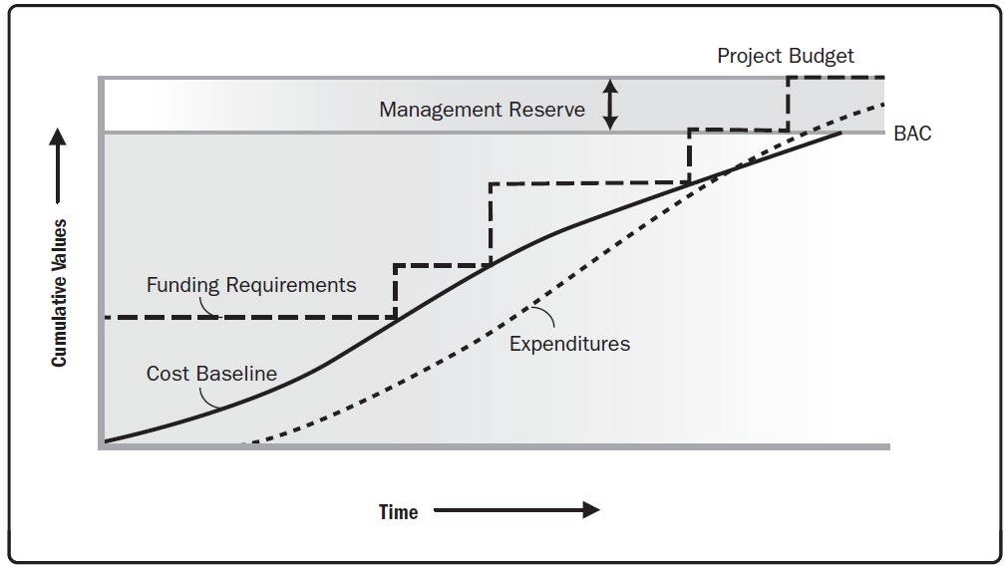
Cost baseline, Expenditures, and Funding Requirements (Figure 7-9 PMBOK ® Guide, 5th Edition)

Slide 39
Sub_Module: CoCoMo and Delphi
Additional Estimation Techniques & Issues
MethodScience.com

Slide 40
Practical advice for better estimating
Build up metrics to improve estimating
Use a standard project structure if possible
Get more than one opinion
Qualify estimates
Document the estimates
Revisit estimates in the light of the project risk analysis

Slide 41
CoCoMo – Constructive Cost Model (Barry Boehm’s Software Engineering, 1981)
Formulae based on thousands of delivered source instructions (KDSI)
Basic, intermediate and detailed versions
Organic projects - "small" teams with "good" experience working with "less than rigid" requirements
Semi-detached projects - "medium" teams with mixed experience working with a mix of rigid and less than rigid requirements
Embedded projects - developed within a set of "tight" constraints. It is also combination of organic and semi-detached projects.(hardware, software, operational,

Slide 42
CoCoMo
The basic COCOMO equations take the form
Effort Applied (E) = ab(KLOC)bb [ man-months ]
Development Time (D) = cb(Effort Applied)db [months]
People required (P) = Effort Applied / Development Time [count]
where, KLOC is the estimated number of delivered lines (expressed in thousands ) of code for project.
The coefficients ab, bb, cb and db are given in the following table:
Software project | a_{b} | b_{b} | c_{b} | d_{b}
Organic | 2.4 | 1.05 | 2.5 | 0.38
Semi-detached | 3.0 | 1.12 | 2.5 | 0.35
Embedded | 3.6 | 1.20 | 2.5 | 0.32

Slide 43
CoCoMo 2
Estimates produced at different stages:
Application composition – based on design from user perspective
Early design – based on top-level design
Post architecture – once detailed design in place and construction has started.
Uses different methods at different stages.
Takes account of innovation, flexibility of approach, fixed or variable scope etc.

Slide 44
Delphi technique
Several estimators are given specification of work and asked for estimates.
Summarized anonymously and results circulated to estimators.
Can revise estimates in the light of others’ ideas.
Method reduces personal disagreements and ego-based issues.

Slide 45
Sub_Module: Investment Appraisal Methods
Highlighting Cost-Benefits through Cost Calculations indicating Returns over a period of time
MethodScience.com

Slide 46
Investment appraisal methods
Payback calculation – simple and straightforward.
Discounted cash flow:
Takes into account ‘time value of money’.
Produces a net present value for project.
Sensitivity analysis can be applied.
Internal rate of return – produces single headline number for comparisons.

Slide 47
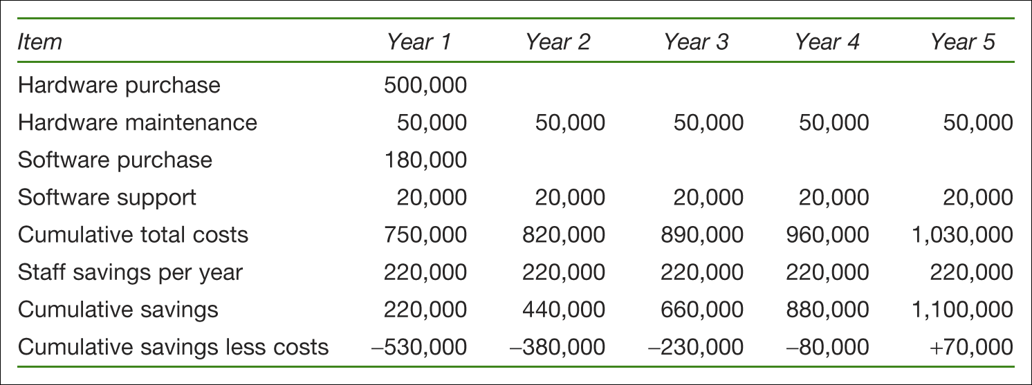
Payback calculation
Table 3.1 Payback projection

Slide 48
Net present value calculation
Year | Cash-flow for year | Discount factor at 20% | Discounted cash flow
1 | –530,000 | 1.000 | –530,000
2 | +150,000 | 0.833 | 124,950
3 | +150,000 | 0.694 | 104,100
4 | +150,000 | 0.579 | 86,850
5 | +150,000 | 0.482 | 72,300
Net present value |  |  | –141,000

Slide 49
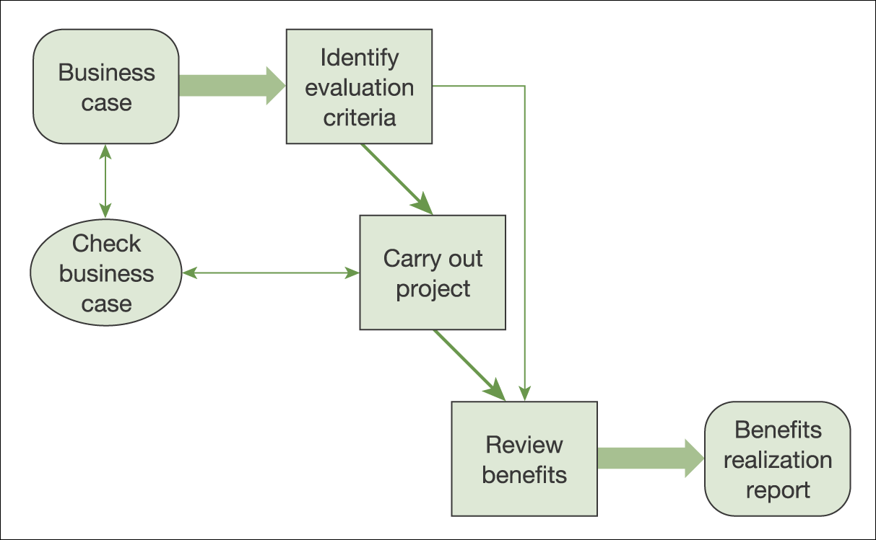
Benefits realization
Figure 3.2 Benefits realization and management

Slide 50
Presenting the business case
Aim
what is this designed to achieve?
Audience
who is making the decision?
Arrangement
logical, leading to the recommendation
Appearance
accessible, attractive, easy to follow

Slide 51
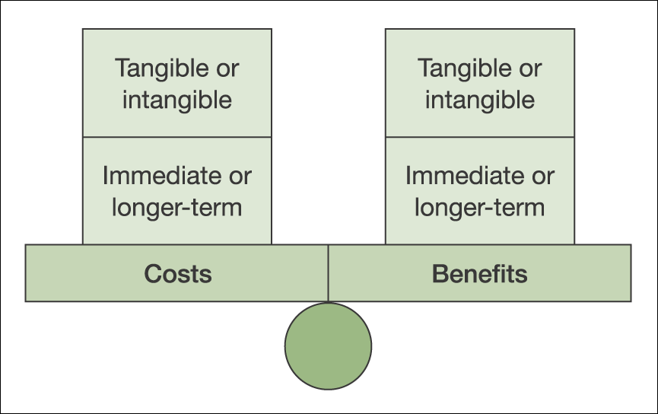
Costs and benefits
Figure 3.1 Costs and benefits

Slide 52
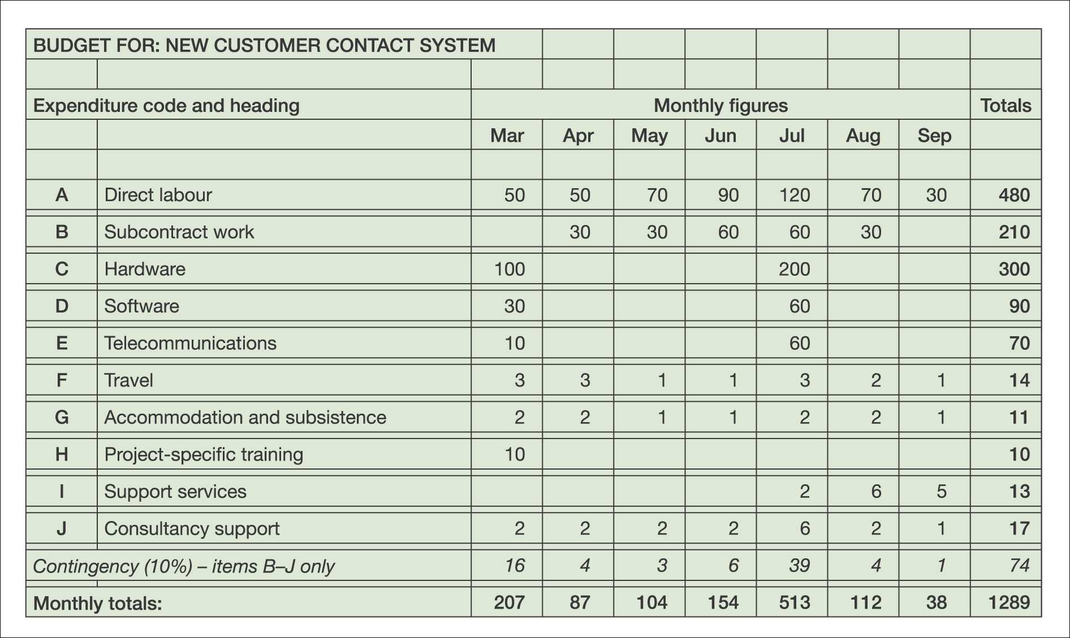
Project budget
Figure 10.13 Example budget for an IT project

Slide 53
Project Funding Requirements
Total funding requirements and periodic funding requirements (e.g., quarterly, annually) are derived from the cost baseline. Funding often occurs in incremental amounts that are not continuous, and may not be evenly distributed.
The total funds required are those included in the cost baseline, plus management reserves. Funding requirements may include the source(s) of the funding.

Slide 54
Short Exercise
Describe the following with Examples:
Cost: ___________________________________
Budget:____________________________________
Expense:__________________________________

Slide 55
Sub_Module: 7.4 Control Costs
Based on Project Cost Management Knowledge Area
(Chapter 7 of PMBOK ® 5th Edition)
MethodScience.com

Slide 56
7.4 Control Costs
Is the process of monitoring the status of the project to update the project costs and managing changes to the cost baseline.
Benefit: provides the means to recognize variance from the plan;
corrective action and minimize risk.
Updating the plan (budgets included) requires knowledge of the actual costs spent to date.
Increase can be approved through the Perform Integrated Change Control process.
Effort of cost control involves analyzing the relationship between the consumption of project funds to the physical work being accomplished for such expenditures.

Slide 57
Tools and Techniques of “Control Costs”
Earned Value Management
Forecasting
To-complete Performance Index (TCPI)
Performance Reviews
Project Management Software
Reserve Analysis

Slide 58
Earned Value Management
Earned value management (EVM) is a methodology that combines scope, schedule, and resource measurements to assess project performance and progress.
It integrates the scope baseline with the cost baseline, along with the schedule baseline, to form the performance baseline, which helps the project management team assess and measure project performance and progress.
The principles of EVM can be applied to all projects in any industry.

Slide 59
Forecasting
As the project progresses, the project team may develop a forecast for the estimate at completion (EAC) that may differ from the budget at completion (BAC) based on the project performance. Forecasts are generated , updated, and reissued based on work performance data.
EACs are typically based on the actual costs incurred for work completed, plus an estimate to complete (ETC).
Equation: EAC = AC + Bottom-up ETC.
EAC forecast for ETC work performed at the budgeted rate. Equation: EAC = AC + (BAC – EV).
EAC forecast for ETC work performed at the present CPI. Equation> EAC = BAC/ CPI.
EAC forecast for ETC work considering both SPI and CPI factors. Equation: EAC = AC + [(BAC – EV) / (CPI × SPI)]

Slide 60
To-complete Performance Index (TCPI)
It is a measure of the cost performance that is required to be achieved with the remaining resources in order to meet a specified management goal, expressed as the ratio of the cost to finish the outstanding work to the remaining budget.
The equation for the TCPI based on the EAC: (BAC – EV) / (EAC – AC).

Slide 61
Performance Reviews
Performance reviews compare cost performance over time , schedule activities or work packages overrunning and underrunning the budget, the estimated funds needed to complete work in progress.
Variance analysis. Variance analysis, as used in the EVM, is the explanation (cause, impact, and corrective actions) for cost (CV = EV – AC), schedule (SV = EV – PV), and variance at completion (VAC = BAC – EAC) variances. The percentage range of acceptable variances will tend to decrease as more work is accomplished.

Slide 62
Outputs of “Control Costs”
Work Performance Information
Cost Forecasts
Change Requests
Project Management Plan Updates
Project Documents Updates
Organizational Process Assets Updates

Slide 63

Key Points (Summary)
Cost estimates require careful planning; they are very closely related to Time estimates
(form part of Cost-Time-Scope Triangle)
Cost estimates feed into Budgets for the Project
Number of Techniques discussed for estimations and budgeting
Analogous, Parametric, 3-Point
CoCoMo-II and Delphi techniques
Controlling Costs is an ongoing management activity – includes Risk Management

Slide 64
Conclusions & Future Directions
We discussed…??
Do you see what we see?

Slide 65

Project Work (In Group)
1) Go to your project work and revisit the Time Estimates
2) Add Cost estimates to the Time estimates
3) Use one (or more) of the techniques discussed here to arrive at your Cost Estimates
4) Ensure you DEMONSTRATE your cost estimation steps in your project report

